Slide 1

Important note for teachers
You must copy the Holiday.jpg image into a shared area your students can easily access and download.

Slide 2
Spotting fake news
Unit: Staying safe and smart online

Slide 3
Objective
I can evaluate the credibility of online information using a checklist.

Slide 4
Keywords
Fake news is false information that is shared online to mislead people or get attention.
Fact-checking is when you check if information is true by looking it up on reliable websites or tools.
Reliability means how trustworthy or dependable something is, like a website or source of information. A reliable source gives accurate, truthful and well-supported facts.

Slide 5
What do you already know?
Not everything on the internet is true.
Some websites and people share information to trick or mislead others.
You can use clues like spelling mistakes or strange links to spot unreliable sources.

Slide 6
Steps to success
Fake news
Identifying reliable vs. unreliable sources
Reverse image search

Slide 7
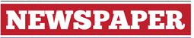

Fake news
In pairs discuss which of these two headlines is real and which one is fake?
SHOCKING! SCIENTISTS DISCOVER A SECRET PILL THAT MAKES YOU LIVE FOREVER
DOCTORS HATE IT!
DREAMS OF CUP GLORY GIVE BATTLING BRADFORD AN ESCAPE FROM TOUGH TIMES AT HOME

Slide 8
Fake News ANSWERS
Fake
Real
SHOCKING! SCIENTISTS DISCOVER A SECRET PILL THAT MAKES YOU LIVE FOREVER
DOCTORS HATE IT!
DREAMS OF CUP GLORY GIVE BATTLING BRADFORD AN ESCAPE FROM TOUGH TIMES AT HOME

Slide 9
Fake news
What clues are there that this is not the real headline?
The claim of living forever is far-fetched and unbelievable.
It uses exaggerated words like “Shocking!” and “Secret Pill” to grab attention.
It does not give a reliable source, only “Newspaper”.
SHOCKING! SCIENTISTS DISCOVER A SECRET PILL THAT MAKES YOU LIVE FOREVER
DOCTORS HATE IT!

Slide 10
Fake news
Fake news is false information shared online to mislead, entertain or cause harm.
It might look like real news but is designed to trick people.
So, let’s look more closely at the different reasons why fake news is created

Slide 11
Fake news
To mislead...
To entertain...
To cause harm...
spread false information to confuse people or push an agenda.
create shocking or funny stories to gain attention or go viral.
damage someone’s reputation, spread fear or create arguments.
Always think critically about what you read online and consider why somebody has created that content.

Slide 12
Fake news
Fake news often spreads quickly because people share the stories.
As more people hear the news and share it further, it reaches a much larger audience in a short amount of time.
This is called “going viral”.
Social media platforms make it even easier for fake news to spread because they promote content that gets a lot of likes, shares and comments, even if it isn’t true.
The more people share without checking, the faster fake news spreads.

Slide 13
Fake news
Talk in pairs and try to answer the following question:
Why do you think people may share fake news stories they see online?
Shocking headlines and dramatic stories make people want to click and share, often without checking if the information is true.
Fake news spreads rapidly because it is designed to grab attention and provoke strong emotions.

Slide 14
Fake news
Fake news often plays on emotions like fear, anger or excitement, making people share it faster.
Social media platforms promote content that gets lots of clicks and shares, even if it’s fake.

Slide 15
Fake news
Sometimes fake news stories may not be so easy to spot as this one and may sound realistic.
But there are still clues you can use to help you identify fake headlines…
SHOCKING! SCIENTISTS DISCOVER A SECRET PILL THAT MAKES YOU LIVE FOREVER
DOCTORS HATE IT!

Slide 16
Fake news
Check for clickbait words:
Clickbait is when a headline or link is written in a way to grab your attention and make you click on it.
Look out for exaggerated or shocking words like “You Won’t Believe”, “Shocking” or “Exclusive.” These are often used to grab attention.

Slide 17
Fake news
Look for spelling or grammar mistakes:
Fake headlines may have errors in spelling, punctuation or grammar, which can be a clue that it may not have come from a trusted and respected source.

Slide 18
Fake news
Verify the source:
Check if the headline comes from a trusted website or news organisation. If it’s from an unknown or suspicious source, it might be fake.

Slide 19
Fake news
Does it sound too good (or bad) to be true?
If the headline seems unbelievable, overly dramatic or far-fetched, it’s worth fact-checking.

Slide 20
Fake news
Fact-checking means checking whether information is true and accurate. It involves looking at reliable sources to confirm the facts.
For example:
Checking if a news story is reported by trusted websites.
Verifying dates, quotes or images to see if they match the claims.
Fact-checking helps you avoid believing or sharing fake news and ensures the information you use is trustworthy.

Slide 21
Fake news
Check the date:
Some fake headlines use old or irrelevant news to mislead people and make them think it is new. Make sure the information is current.

Slide 22
Fake news
Look for supporting evidence:
Reliable headlines are usually backed by facts, quotes or data. If the headline doesn’t link to evidence, it could be fake.

Slide 23
Fake news
Beware of emotional manipulation:
Headlines designed to make you angry, scared or overly excited are often fake or misleading.

Slide 24
1: Fake news
Create your own fake news headline that contains one or more clues that it isn’t real. Consider using clickbait words to grab attention, spelling or grammar mistakes, out-of-date news, an unreliable source, emotional manipulation or make it sound too good or bad to believe.
Pass that headline to a partner and ask them to identify the specific clues that give away it is fake.

Slide 25
Steps to success
Fake news
Identifying reliable vs. unreliable sources
Reverse image search

Slide 26
Identifying reliable vs. unreliable sources
As we have seen, in today’s world, not everything we see online is true.
Some websites and articles are reliable and give us accurate information, while others are misleading or even fake.

Slide 27
Identifying reliable vs. unreliable sources
It’s important to look for reliable websites because they provide accurate and trustworthy information.
Using unreliable sources can lead to spreading false facts, making poor decisions or being misled by fake news.
Knowing how to tell the difference between a reliable and an unreliable website is an important skill that helps us make good decisions and stay safe online.

Slide 28
Identifying reliable vs. unreliable sources
A website domain is the name of a website, like 'bbc.co.uk,' that helps you find it on the internet.
Reliable domains often end in .gov, .edu or .org.
Be cautious of unknown or unusual domains like .xyz or .info.

Slide 29
Identifying reliable vs. unreliable sources
Look for the author’s name and their qualifications.
A reliable source will have an author who is an expert in the topic.

Slide 30
Identifying reliable vs. unreliable sources
Reliable articles include facts, data or quotes from experts.
Check if the article links to other trustworthy sources.

Slide 31
Identifying reliable vs. unreliable sources
There are lots of clues you can look for to help you spot websites that may be unreliable.
Clickbait headlines that are exaggerated or shocking, like “You Won’t Believe This!”
Reliable sources are carefully edited, while fake ones often have mistakes.

Slide 32
Identifying reliable vs. unreliable sources
Unreliable articles might use words to make readers angry, scared or excited.
Look for neutral and factual language instead.
If there’s no author or no sources listed, the article might not be trustworthy.

Slide 33
Identifying reliable vs. unreliable sources
Have a look at this website:
All About Explorers https://www.allaboutexplorers.com/explorers/
Decide if it is a reliable or unreliable source and explain to a partner why you believe that.

Slide 34
Identifying reliable vs. unreliable sources ANSWERS
It is an unreliable website.
The website includes false facts about famous explorers, such as incorrect dates, events and achievements.
The site does not provide details about the authors or their qualifications, which raises questions about its trustworthiness.
The articles do not reference credible sources or provide links to evidence supporting the claims made.
If you’d explore the “About” section, you’ll see that it openly states the site is designed to teach critical thinking and is not a genuine resource.

Slide 35
Identifying reliable vs. unreliable sources
Have a look at this website:
Inca civilization https://kids.nationalgeographic.com/history/article/inca-civilization
Decide if it is a reliable or unreliable source and explain to a partner why you believe that.

Slide 36
Identifying reliable vs. unreliable sources ANSWERS
It is a reliable website.
The website looks professional and well-maintained, with no spelling or grammar mistakes.
The National Geographic logo is prominently displayed, which is a sign of credibility.
The headline is clear and factual: “Inca Civilization.” It doesn’t use exaggerated or shocking language.
The article provides specific details about the Inca civilisation, such as their achievements and way of life, which can be cross-checked with other trusted sources.
The website has minimal advertising, making it clear that the focus is on education rather than profit.

Slide 37
Identifying reliable vs. unreliable sources
Which of these are clues of reliability?
The author’s name is provided.
The article uses a clickbait headline.
Clear evidence, like data or quotes, is included.
The website has lots of spelling mistakes.
The website’s domain is unusual, like .xyz.
The article links to trusted sources.
✓
✗
✓
✗
✗
✓

Slide 38
2: Identifying reliable vs. unreliable sources
Write 3 tips to help someone decide if a website is reliable.
Each tip should be short (1-2 sentences) and easy to understand.
Use examples to make your tips clearer, e.g., “A trusted website might ...”

Slide 39
2: Identifying reliable vs. unreliable sources ANSWERS
Check if the website has an author who is an expert, like a scientist or teacher.
Avoid websites with clickbait headlines like “You Won’t Believe This!”
Look for facts and evidence, like links to other trusted sources of data.
You may have written other tips, such as looking at the website domain, checking the date or noticing spelling mistakes.

Slide 40
Steps to success
Fake news
Identifying reliable vs. unreliable sources
Reverse image search

Slide 41
Reverse image search
Metadata is like a “hidden label” that tells you more about a file, like a photo, document or video. It’s extra information stored with the file that you don’t always see right away.
When you take a photo on your phone, metadata might include:
When the photo was taken (date and time).
Where it was taken (location if GPS is on).
What camera or phone was used to take it.

Slide 42
Reverse image search
Reverse image search is a useful fact-checking tool that helps you verify where an image comes from and whether it matches the claims being made.
Reverse image searche involves analysing an image to uncover its origin, context and authenticity.
This includes looking at the metadata, using reverse image search tools and examining clues within the image itself.

Slide 43
Reverse image search
How can this help us spot fake news?
Helps identify if an image has been altered or taken out of context.
Ensures the image is from a reliable source and hasn't been manipulated.
Provides insights into where and why the image was originally used.

Slide 44
Reverse image search
A photo of a shark on a flooded street might look real but a reverse image search can reveal it’s a digitally altered image combining a shark and a flood photo.
You may see a photo in a news story showing a huge crowd at a protest. The caption says, "This protest happened yesterday and thousands of people joined!"
When you use reverse image search, you find that the same photo was actually used in a news article from five years ago about a completely different event. This proves the image is being reused and the caption is misleading.

Slide 45
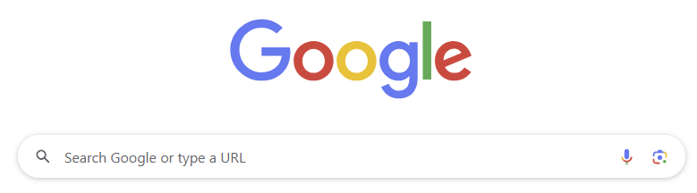
Reverse image search
To do a reverse image search you need to have a copy of the image saved.
Then go to Google.
Click on this icon

Slide 46
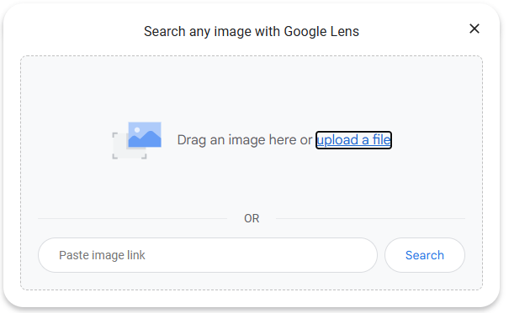
Reverse image search
Upload your file.

Slide 47
Reverse image search
When you do a reverse image search, the results might show similar images or websites that have used the same image before.
You can click on these links to check where the image came from. Look for clues like:
Is the website reliable and well-known?
Does the image match the story it’s being used for?
Are there any dates or details that seem wrong?
If the website or information doesn’t seem trustworthy, the image might be part of fake news.

Slide 48
Reverse image search
A news story has emerged about a sighting of a mysterious monster in a swimming pool.
The headline says, “Shocking new picture! Is Nessy on holiday?”
The image is saved as Holiday.jpg. Do a reverse image search and decide if the sources of similar images are reliable.

Slide 49
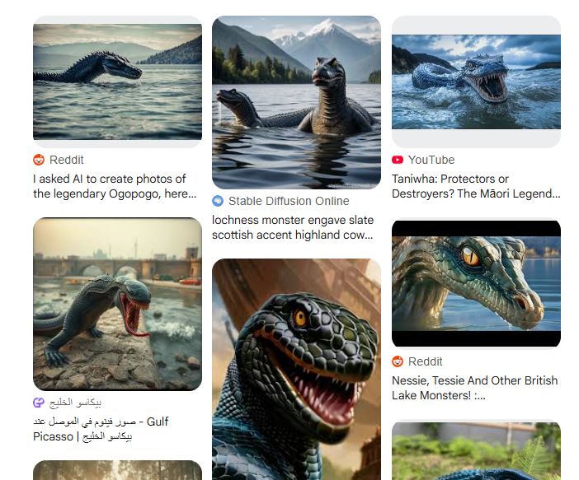
Reverse image search ANSWER
No, they are not reliable sources.
The sites which contain similar images are Reddit, YouTube, TikTok and an image generation site. These are not reliable sources for news.

Slide 50
Summary of lesson
Fake news is false information shared to mislead or get attention.
Reliable sources have clear authors, evidence and trustworthy domains.
You can use tools like a reverse image search to check the sources of images.
In this lesson, you used analytical thinking when you evaluated sources and identified fake news clues.

Slide 51
© 2025 Nichola Wilkin Ltd
https://www.nicholawilkin.com/terms

